Slide 1


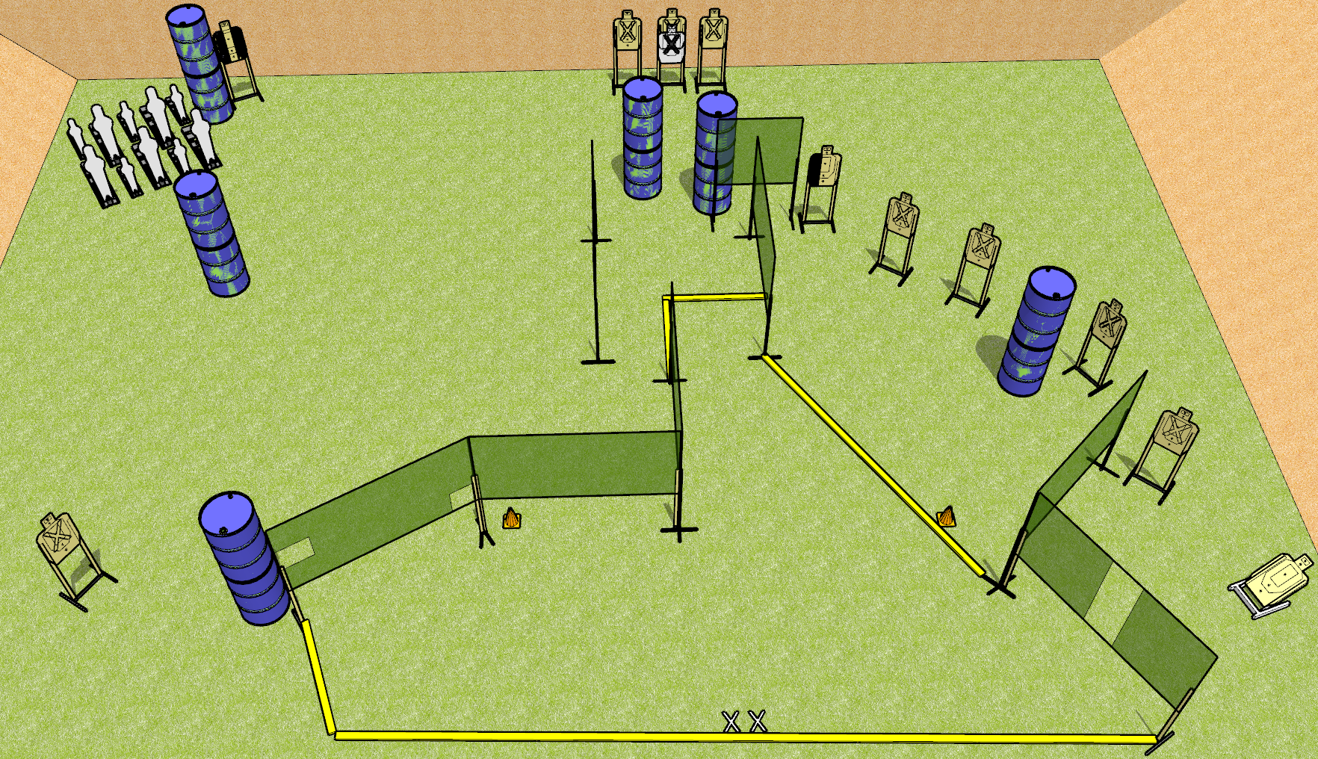
 | Dothan Gun Club – USPSA Match Too Much Steel Course Designer : Drew Coleman
START POSITION : Standing with both feet on X’s
GUN READY CONDITION : Pistol loaded and holstered. PCC shouldered, safety on, pointed at either orange cone. |  | SCORING: Comstock, 32 rounds TARGETS: 11 paper, 10 Steel SCORED HITS: Best 2 on paper, steel until down START-STOP: Audible, last shot RULES:
STAGE PROCEDURE: Engage targets as they become available from within the fault lines

